Slide 1
Hotel Digital Concierge
Brian Maina, Corey McPherson, Christine Olukere, Baris Senyurt

Slide 2
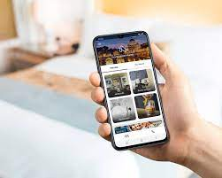
What is a Hotel Digital Concierge
A software application designed to help hotel guests with various needs and tasks while taking pressure off front desk staff
Digital concierges are increasingly being integrated with AI

Slide 3
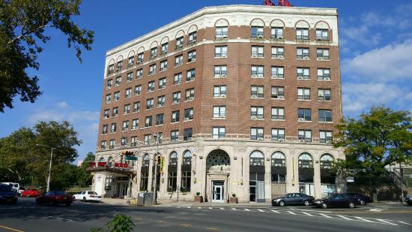
Benefits for Hotels
Efficiency
AI driven automation can handle various operation processes such as check in-checkouts, and service requests, reducing workload of hotel staff
Automating tasks allow staff to focus on more complex and guests centric activities and allows for a leaner hotel staff
Digital Insights:
AI tools can analyze vast amounts of data collected by digital concierge system to generate insights on guest preferences and behaviors, preferences and trends.
This can be used to enhance services and marketing strategies

Slide 4

Benefits for Guests
Convenience:
Streamlined Checking In/Checkout: Guests can expedite the checkin and checkout processes, reducing wait times and paperwork
Standalone Hotel App: Access to concierge services through a mobile app allows guests to make requests or inquiries from anywhere in the hotel
Personalization
Customized Experienced : Hotels can use AI algorithms to analyze guests preferences to provide personalized recommendations for services, amenities, and local activities
Room Preferences: Guests can set room preferences in advance, such as temperature, lighting, and entertainment preferences

Slide 5
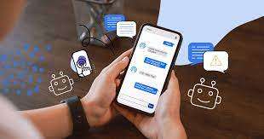
Chatbots
Chatbots: Chatbots are computer programs designed to simulate conversation with human users, especially over the internet.
Implemented with NLP capabilities enables guests to interact with the digital concierge using nature language.
Understand and respond to user queries more effectively.

Slide 6

AI Room Services
The room service experience can be greatly improved by the integration of artificial intelligence.
Integrating AI technology into Marriott and other hotel’s room services will offer an enhanced guest experience.
However, the key is maintaining a balance between the technology and an authentic human experience.
Corey

Slide 7
AI Room Services
AI technology can track and analyze guest preferences and behavior to tailor a personalized experience for the guest’s stay.
The AI can provide predictive room maintenance that connect to the room’s HVAC systems or room appliances to ensure a comfortable stay for the guest.
Features for Efficiency:
In-app or device voice assistant for ease of access
Convenient In-app purchases
Corey
Notes:
These features are guest-facing as they require initial human interaction to begin performance. Devices like Amazon Alexa are examples of guest-facing technologies.

Slide 8
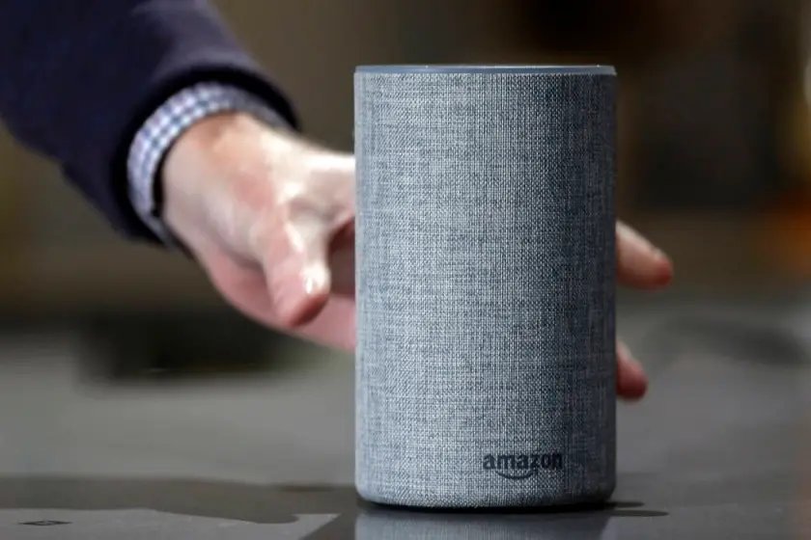
AI Room Services - Real World Examples
In 2017, Amazon introduced a version of Alexa for Hospitality, partnering with Marriott, RedAwning, and Two Roads Hospitality.
This version of Alexa allows guests to request services, control room features, and access information.
Corey
Notes:
This version of Alexa allows guests to request services, control room features, and access information. Hotels can customize Alexa for specific properties and utilize guest data for improved interactions. Future plans include guest account integration and personalized recommendations. There are concerns about privacy implications and the need for educating guests about data usage.

Slide 9
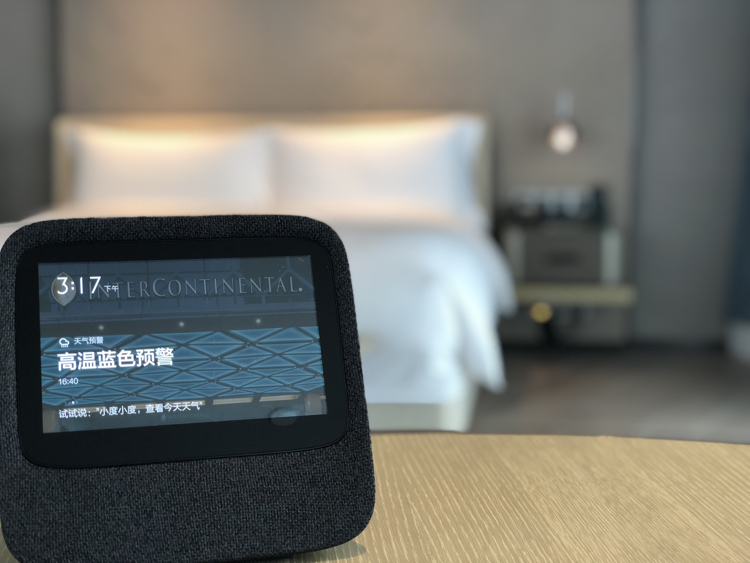
AI Room Services - Real World Examples Cont.
IHG's InterContinental Hotels & Resorts collaborated with Baidu to introduce AI-powered Smart Rooms in China.
The Smart Rooms enable guests to personalize settings, access seamless room service, and simplify hotel management through advanced AI technology.
Corey
Notes:
These rooms, initially available in InterContinental Beijing Sanlitun and InterContinental Guangzhou Exhibition Centre, feature Baidu's DuerOS Platform, integrating AI for voice-controlled experiences.

Slide 10
AI Luggage services
A type of guest facing AI that can be implemented in Hotels
Guests would receive the help of AI robots that would be able to help them with luggage
This robot should be capable of lifting enough weight to handle most luggage

Slide 11
Key Features
Would Welcome guests with a message
Would be easy and seamless for the guests to use
Would work with other systems in the hotel
Streamlined for best possible guest communication

Slide 12
Key Features (cont.)
An automated luggage tagging process
Uses RFID technology to accurately identify luggage
Would be capable of providing hotel guests with real time updates

Slide 13
Managing Luggage
Mobile app would provide guests all the tools to monitor luggage
Guests would be notified whereabouts of the luggage
App would allow guests to pay for this service on the mobile app and should be able to manage and plan all of their luggage seamlessly before and after checkout

Slide 14
Real life Examples
Yotel, a hotel in NY uses an AI robot to help guests manage their luggage with storage before and after checkout
Can lift 500 lbs of luggage and handles on average 300 bags on a daily basis
Guests take their bags to their own rooms
Yotel uses a kiosk system for guests to check-in
95% of guests prefer the AI luggage system over hotel staff

Slide 15
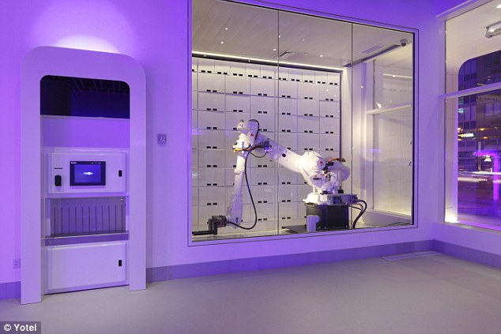

Slide 16
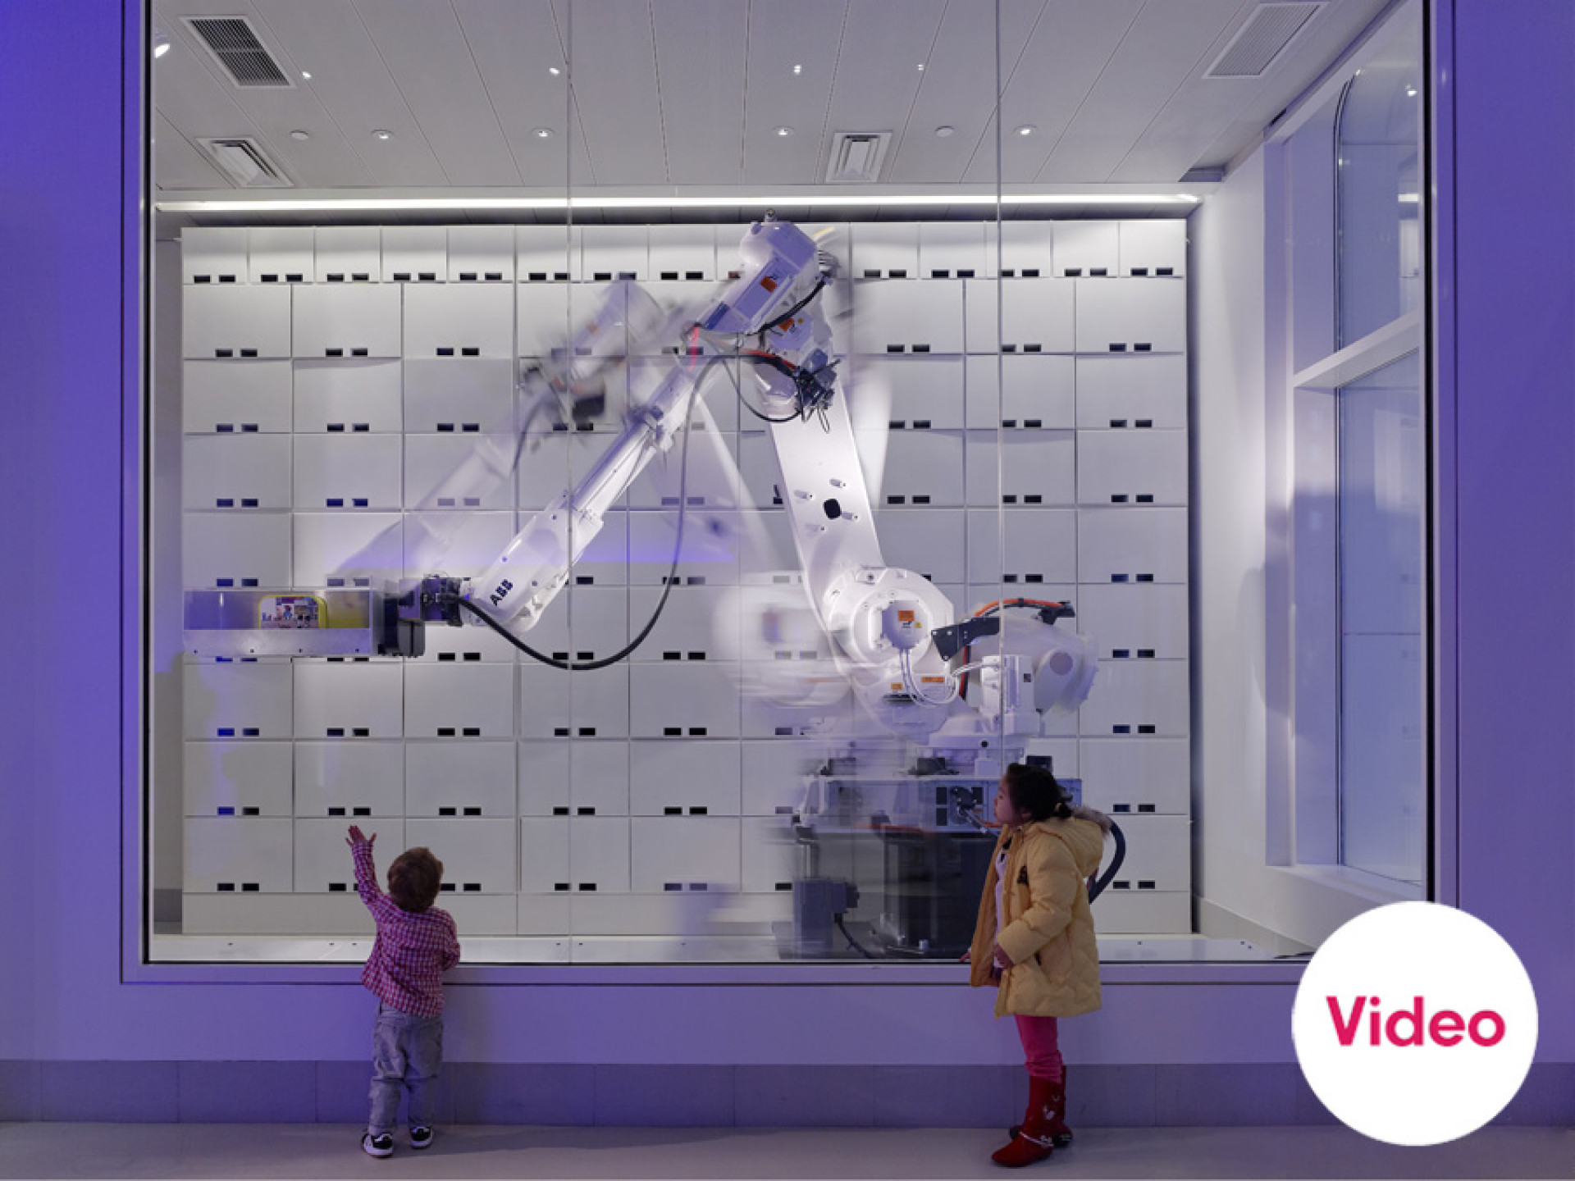

Slide 17
Guest Satisfaction
Saved time for guests and hotel staff
A more positive impact on guest satisfaction (95% of customers prefer this service)
Future proof with more enhancements and expandable for maximum customer satisfaction
Affordable luxury service

Slide 18
Benefits of AI luggage Service
Can Cost-effective solution for a highly desirable service that would replace staff
Fairly simple to implement
Can eliminate human error when handling personal luggage for guests

Slide 19
AI integration in guest check in/check out systems
We analysed the findings of two studies that measured the positive feedback
of guest facing AI systems during the COVID-19 pandemic in Singapore. The first study used different methods of analysis (TAM, Privacy Calculus Theory, and Personal Innovativeness) while the article by Chang et al. offers real-world guest feedback on automatic check-in/out systems in Singapore.

Slide 20

Video explaining TAM

Slide 21
Efficiency and Modern Appeal
Positive reviews highlight the speed and efficiency of AI check-in/out systems, with guests appreciating the futuristic and modern aspects of the technology (Chang et al.)

Slide 22
Guests’ Cognitive Process
Both studies reveal that guests weigh benefits (efficiency, modernity) against risks (privacy concerns, lack of personal touch) when interacting with facial recognition and AI systems (Boo & Chua, 2022; Chang et al.).

Slide 23
Trust and Privacy Concerns
While trust enhances focus on benefits (Boo & Chua, 2022), privacy concerns are a significant issue, especially when personal details are visible in public areas during self-check-in (Chang et al.).

Slide 24
Lack of Personal Interaction
Negative reviews often cite the absence of a human element in automated check-ins, suggesting a need for balancing AI with human hospitality (Chang et al.).

Slide 25
Usability Challenges
The difficulty in using self-check-in systems, often requiring staff assistance, points towards a need for more user-friendly interfaces (Chang et al.)

Slide 26
Implications for Hotel Management
Marriott should consider these findings in strategizing the deployment of AI systems, focusing on enhancing user experience while addressing privacy and personal interaction concerns (Boo & Chua, 2022; Chang et al.).

Slide 27
Millennials and Gen Z as Key Demographics
The adoption of such technologies is particularly promising for younger, tech-savvy generations, as noted in Boo and Chua’s study (2022).

Slide 28
Enhancing Institutional Trust
To increase acceptance of AI systems, hotels should work on building institutional trust and ensuring privacy safeguards (Boo & Chua, 2022).

Slide 29
Integrating Technology with Hospitality
Balancing the efficiency of AI with the warmth of human service could be key to optimizing guest satisfaction in the digital age (Chang et al.).

Slide 30
Which Hotels Brands Should Use AI
Courtyard by Marriott
Widespread presence in urban and suburban locations.
Could benefit from AI in terms of increased efficiency due to leaner staff

Slide 31

References
Boo, H.C., & Chua, B.L. (2022). An integrative model of facial recognition check-in technology adoption intention: the perspective of hotel guests in Singapore. International Journal of Contemporary Hospitality Management.
Chang, H.H., Ng, E., Chua, J., Blower, M., de Souza, S., & Gwee, T. Marriott International: Deploying AI Across Hotel Brands in Singapore. Singapore Management University.
Digital Concierge: https://www.quoality.com/blogs/digital-concierge-revolutionizing-the-hospitality-industry
https://www.reviewjournal.com/business/casinos-gaming/amazon-announces-version-of-alexa-for-hotels/
https://www.ihgplc.com/en/news-and-media/news-releases/2018/intercontinental-hotels-and-resorts-launches-artificial-intelligence-rooms-in-greater-china

